Slide 1

A Comparative Study on Hyperspectral Image Classification
Batch No: B-5 Project Guide:
SUMIYA KOUSAR S B (164G1A05A7) Mr. P.Veera Prakash, M.Tech.,
RESHMA N (164G1A0581) Assistant Professor
RAJESH E (164G1A0572)
VISHNUKANTH T (164G1A05B8)
https://github.com/sumiyakousar/A-Comaparative-Study-on-Hyperspectral-Image-Classification
Srinivasa Ramanujan Institute of Technology
Department of Computer Science & Engineering

Slide 2
Abstract
Hyperspectral images mostly contain hundreds of spectral bands that can make a continuous spectral signature for every observed pixel. This property makes them useful for earth observation, and remote sensing tasks such as image classification, anomaly detection, and target detection.
In remote sensing, Hyperspectral image (HSI) classification is a phenomenal mechanism to analyze diversified land cover in remotely sensed hyperspectral images. The basic goal of hyperspectral image classification is to assign a class label to each pixel.

Slide 3
Contd…
Classification of hyperspectral data challenging for traditional machine learning methods. In addition, HSI often deals with an inherently nonlinear relation between the captured spectral information and the corresponding materials. In recent years, deep learning has been recognized as a powerful feature-extraction tool to effectively address nonlinear problems.
In this study, we are perform HSI classification on datasets like Indian pines (IP), Salinas (SA) and Pavia University (PU) using the classifier’s like SVM , Random forest, CNN and MLP then by observing the metric values we present a comparative study on HSI classification using machine and deep learning methods.

Slide 4
Existing System
During the survey , the study on HSI classification we observed that due to complex characteristics of hyperspectral data make the accurate classiﬁcation of such data challenging for traditional machine learning methods.
Traditional classifiers and dimensionality reduction methods will not address non-linear problems effectively.

Slide 5
Proposed System
We will perform a comparative study on HSI classification using traditional machine learning and deep learning methods . We are using SVM, Random Forest from traditional machine methods and CNN, MLP from deep learning methods.
In this study, we present that deep learning methods improves the classification accuracy compared to traditional machine learning methods.

Slide 6
Problem Definition
Hyperspectral image (HSI) classification is a phenomenal mechanism to analyze diversified land cover in remotely sensed hyperspectral images.
In the remote sensing community, the term classification is used to denote the process that assigns individual pixels to a set of classes. The output of the classification step is known as the classification map.

Slide 7
Requirements
Hardware Requirements:
RAM 8GB minimum, above 8 GB recommended
Disk space required is 5GB for python, required packages and dataset installations
Processor Intel core i5 or above
Software Requirements:
Operating system – Windows, Linux and Mac OS
Platform - Jupyter Notebook
Python 3.7.6

Slide 8
Literature Survey
“Deep Learning for Hyperspectral Image Classification: An Overview” [1]:
HSI posses complex characteristics of hyperspectral data accurate classiﬁcation of such data challenging for traditional ML methods. Hyperspectral imaging often deals with an inherently nonlinear relation between the captured spectral information and the corresponding materials. Deep learning has been recognized as a powerful feature extraction tool to effectively address nonlinear problems . In this paper it was presented that deep learning methods shows good performance on HSI classification.

Slide 9
Contd…
“ A Comparative Study for Hyperspectral Data Classification with Deep Learning And Dimensionality Reduction Techniques” [2]:
Traditional classifiers and Dimensionality reduction methods are difficult tasks in the spectral domain and cannot extract discriminative features. Deep CNN’s classify hyperspectral images directly in the spectral domain. In this paper, comparative study among traditional data reduction techniques and CNN. The obtained results on hyperspectral image data sets show that CNN architecture improves the accuracy rates for classification performance, when compared to traditional methods.

Slide 10
Contd…
“Hyperspectral Image Classification by exploiting Convolutional Neural Network” [3]:
The main goal of this paper is to use deep learning concept to extract deep features from hyperspectral datasets to achieve better classification results. In this study, after pre-processing step, data is fed to a CNN in order to extract deep features. Extracted features are then imported in a multi-layer perceptron (MLP) network as our selected classifier. These results expressed more than 10% improvements compared to the classic MLP classification technique.

Slide 11
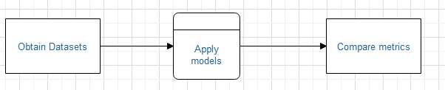
Design (Data Flow Diagrams)
Level-0

Slide 12
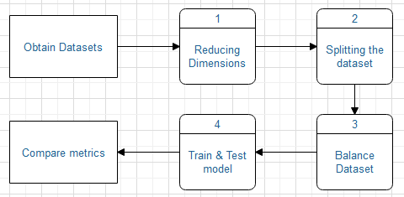
Contd…
Level- 1

Slide 13
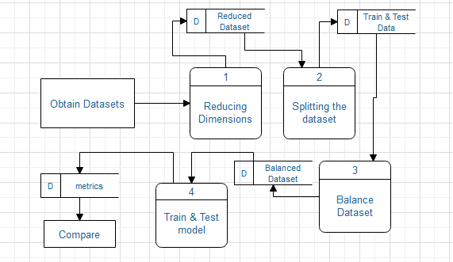
Contd…
Level -2

Slide 14
Machine learning Algorithms
SVM is a supervised learning algorithm that analyses data used for classification and regression. It constructs a hyperplane in multidimensional space to separate different classes. SVM are of two linear and non linear based on hyperplane. A non linear SVM is achieved using kernel tricks. We used non linear SVM with RBF kernel.
Random Forest (RF) is a supervised which is used for both classification as well as regression. It creates decision trees on data samples and then gets the prediction from each of them and finally selects the best solution by means of voting.

Slide 15
Deep learning Algorithms
A multilayer perceptron (MLP) is a deep, artificial neural network. It is composed of more than one perceptron. They are composed of an input layer to receive the signal, an output layer that makes a decision or prediction about the input, and in between those two, an arbitrary number of hidden layers that are the true computational engine of the MLP.
Convolutional neural network (CNN) is a special type of feed forward artificial neural network in which connectivity pattern between its neurons is inspired by the organization of the animal visual cortex. It contains an input layer , an output layer and a hidden layer includes multiple convolutional layers, pooling layers, fully connected and normalization layers.

Slide 16
Metrics
In the ﬁeld of hyperspectral image classiﬁcation, a widely used way for objective performance evaluation of different classiﬁcation methods is calculating three accuracy indexes, i.e., the overall accuracy (OA), the average accuracy (AA), and the Kappa coefﬁcient (kappa).
The accuracy indexes are obtained by comparing the classiﬁcation results with the ground truth, i.e., a reference classiﬁcation map labeled by human experts.

Slide 17
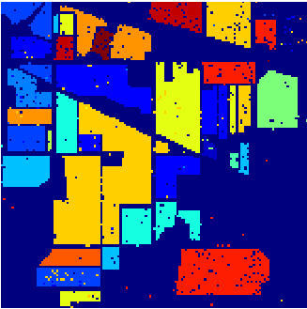
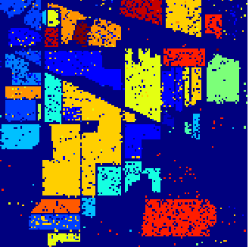
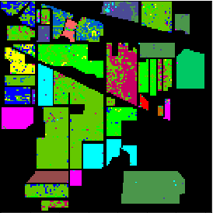
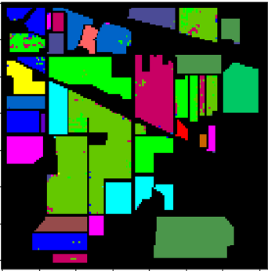
Classification maps of Indian Pines
SVM
RF
MLP
CNN

Slide 18
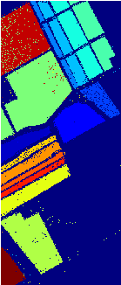
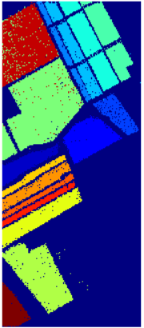


Classification maps of Salinas Scene
SVM
RF
MLP
CNN

Slide 19
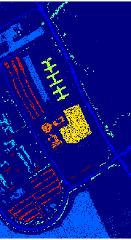
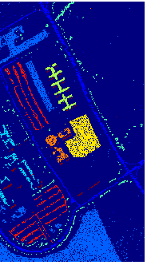
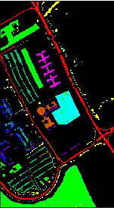
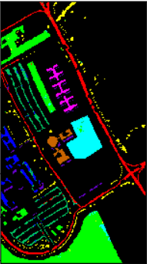
Classification maps of Pavia University
SVM
RF
MLP
CNN

Slide 20
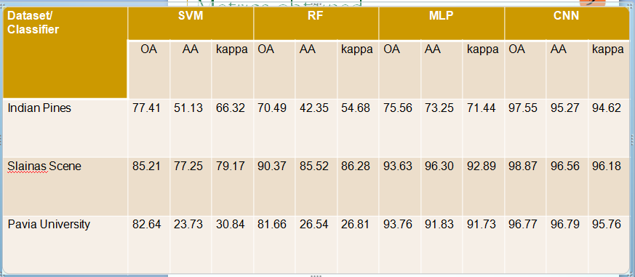
Metrics obtained
Salinas Scene

Slide 21
Conclusion
In this project we performed classification of hyperspectral image by using machine learning and deep learning classifiers. The three metrics OA, AA, kappa are adopted for performance evaluation of classification methods.
By comparing the metrics obtained from classification method we came to conclusion that deep learning methods are better for classification of hyperspectral image.

Slide 22
References
[1] S. Li, W. Song, L. Fang, Y. Chen, P. Ghamisi and J. A. Benediktsson, "Deep Learning for Hyperspectral Image Classification: An Overview," in IEEE Transactions on Geoscience and Remote Sensing, vol. 57, no. 9, pp. 6690-6709, Sept. 2019.
[2] Ortaç, Gizem & Ozcan, Giyasettin. (2018). A Comparative Study For Hyperspectral Data Classification With Deep Learning And Dimensionality Reduction Techniques. Uludağ University Journal of The Faculty of Engineering. 23. 73 - 90. 10.17482/uumfd.435723.

Slide 23
Contd…
[3] Hosseiny, Benyamin & Rastiveis, Heidar & Daneshtalab, Somaye. (2019). Hyperspectral Image Classification By Exploiting Convolutional Neural Networks. ISPRS - International Archives of the Photogrammetry, Remote Sensing and Spatial Information Sciences. XLII-4/W18. 535-540. 10.5194/isprs-archives-XLII-4-W18-535-2019.
[4] S. Li, Q. Hao, G. Gao and X. Kang, "The Effect of Ground Truth on Performance Evaluation of Hyperspectral Image Classification," in IEEE Transactions on Geoscience and Remote Sensing, vol. 56, no. 12, pp. 7195-7206, Dec. 2018.

Slide 24
Thank you
Queries
?

